Slide 1

Build the
Intelligent, Integrated Enterprise
An Overview of the Home Mortgage
Origination Demo
Powered by JBoss Enterprise Middleware –
ESB, Messaging, BRMS, Data Virtualization and BPM
TITLE SLIDE: HEADLINE
Presenter name
Title, Red Hat
Date

Slide 2
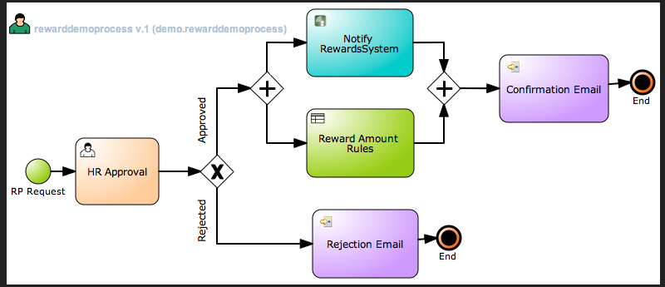

Home Mortgage Origination Demo Application
JBoss ESB
jBPM process
Loan
App
SOAP
ESB WS
Service
PreQualification
Orchestration
(RiftSaw)
Loan
App
File
ESB File
Service
URLA
1003
ESB
Service
Loan
App
AMQP / JMS
ESB JMS
Service
Business
Events
Complex Event
Processing
Service
Decision
Service
(EBWS)
Rules
Repository
(BRMS)

Slide 3
Build the
Intelligent, Integrated Enterprise
For more information, please visit
http://www.jboss.com
Demo code available at
https://github.com/eschabell/homeloan-integration-demo
TITLE SLIDE: HEADLINE
Presenter name
Title, Red Hat
Date

